Slide 1
Pre processor in C

Slide 2
The pre-processing stage is the first step undertaken on your source code before the compilation begins and the C pre-processor program is responsible for this.
The C pre-processor also known as cpp or macro processor, modifies a source code file before handing it over to the compiler.
The C pre-processor does this by following pre-processor directives.

Slide 3
Pre-processor directives
Pre-processor programs execute pre-processor directives that pre-process your source code before compiling.
These directives are commands that tell the pre-processor to do things like skip part of a file, include another file, or define a constant or a macro.
All of these pre-processor directives begin with a ‘#’ (hash) symbol. The ‘#’ symbol indicates that whatever statement starts with a ‘#’ will go to the pre-processor program to get executed.
Examples of some pre-processor directives are:
#include, #define, #ifndef

Slide 4
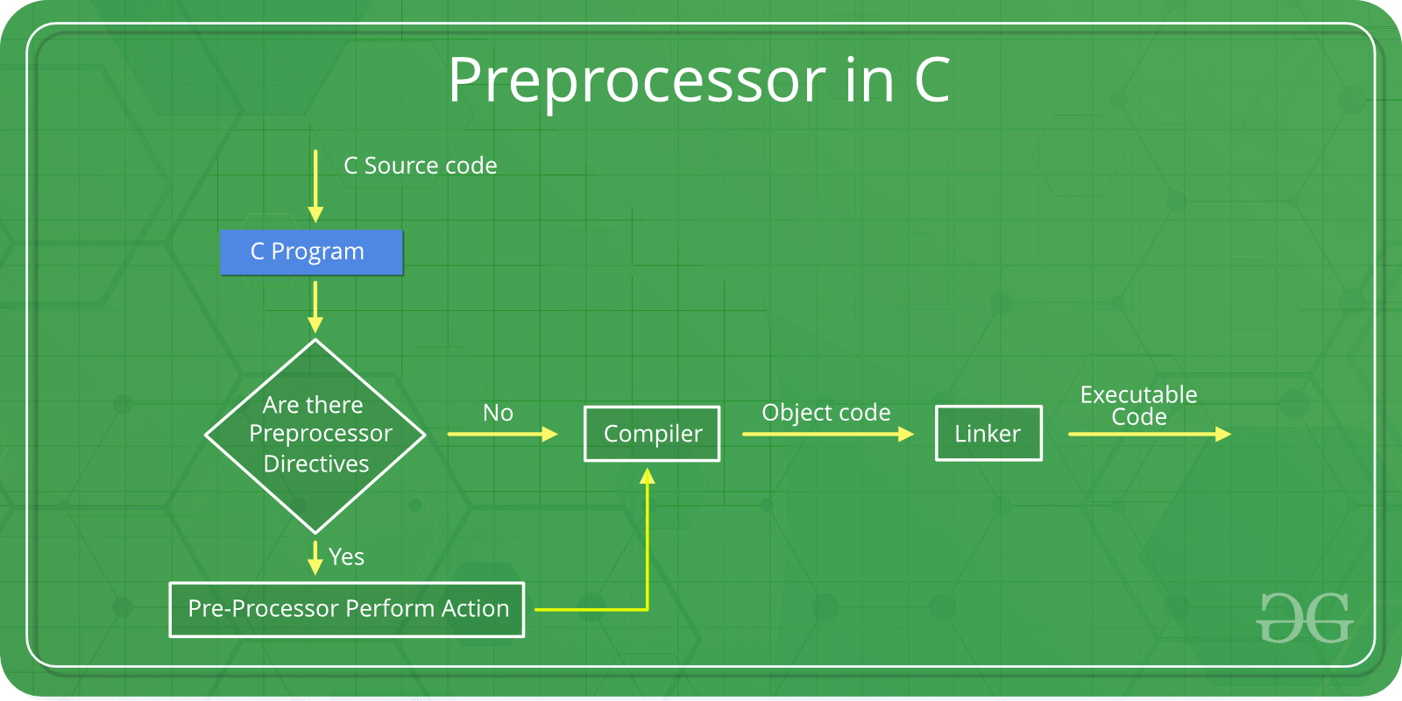

Slide 5
Various types of Pre-processor Directives:
1. File Inclusion
2. Macros and Constants definition
3. Conditional Compilation

Slide 6
1. File Inclusion
This type of pre-processor directive tells the compiler to include a file in the source code program.
There are two types of files that can be included by the user in the program:
1.Header files or Standard files
These header/standard files contain definitions of functions like printf(), scanf(), etc. These header files must be included in your source code for you to be able to use these pre-defined functions.
Different functions are declared in different header files. For example, standard I/O functions are in the stdio.h file hence #include <stdio.h>
#include <string.h> to access your string functions

Slide 7
2. User-defined files
When a program becomes very large, it is a good practice to divide it into smaller files and include them whenever needed.
These types of files are user-defined files. These files can be included using the syntax #include "filename"
eg for alx : #include "main.h"

Slide 8
2.Macros and Constants defintion
Macros are pieces of code in a program that is given a particular name.
Whenever this name is encountered by the compiler, the compiler replaces the name with the actual piece of code.
The ‘#define’ directive is used to define a macro.
#include <stdio.h>
#define LIMIT 5
int main( )
{
for (int i = 0; i < LIMIT; i++) {
printf("%d \n",i);
}
return 0;
}

Slide 9
Constants refer to fixed values that the program may not alter during its execution.
You define a constant using the pre processor directive #define:
#define <VAR_NAME> <VALUE>
<VAR_NAME> is a placeholder for the name of the constant.
It's recommended that you name constants in the uppercase, as it helps differentiate them from other variables defined in the program.
<VALUE> is a placeholder for the value that <VAR_NAME> takes.
Before the compilation of the program, the pre-processor replaces all occurrences of <VAR_NAME> with <VALUE>.

Slide 10
#include <stdio.h>
#define STUDENT_ID 27
#define COURSE_CODE 502 //constant definition
int main()
{
printf("Student ID: %d is taking the class %d\n", STUDENT_ID,COURSE_CODE);
return 0;
}

Slide 11
3.Conditional Compilation
Conditional Compilation directives are a type of directive that helps to compile a specific portion of the program or to skip the compilation of some specific part of the program based on some conditions.
This can be done with the help of the two pre-processing commands ‘ifdef‘ and ‘endif‘.
Syntax:
#ifdef macro_name
statement1;
statement2;
statement3;
#endif

